Slide 1
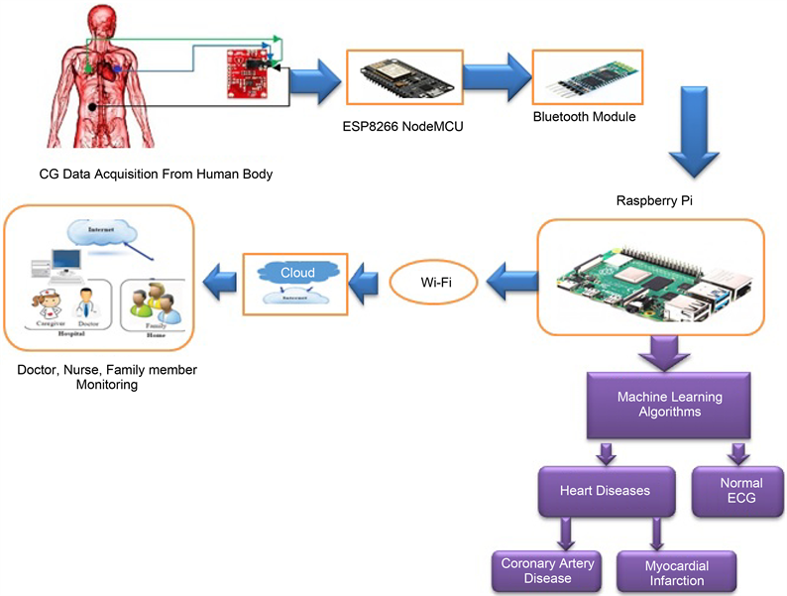
IoT in Healthcare: Revolutionizing Patient Care
Ram Bahadur Singh Kushwaha
05/01/2023
This Photo by Unknown Author is licensed under CC BY

Slide 2
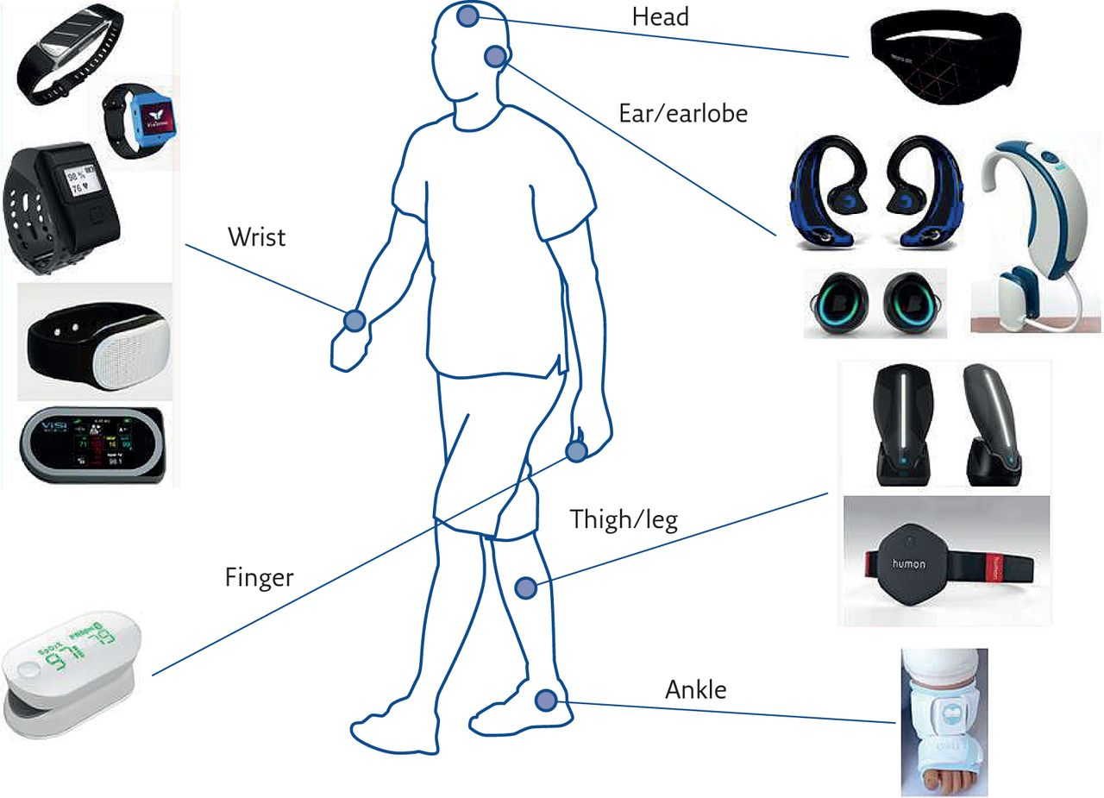
IOT in Healthcare
IoT, or Internet of Things, refers to the network of physical devices, vehicles, appliances, and other objects embedded with sensors, software, and connectivity, enabling them to connect and exchange data.
In healthcare, IoT is used to create a connected ecosystem of medical devices, wearables, and sensors that collect and transmit data in real-time. This data can be used to monitor patient health, improve diagnostics, and enhance patient care.
This Photo by Unknown Author is licensed under CC BY-NC

Slide 3
Data Acquisition
Data acquisition is the fundamental process of collecting patient data through specialized sensors in healthcare IoT. These sensors, ranging from temperature sensors to heart rate monitors, play a pivotal role. They convert real-world physical signals, such as body temperature or heartbeats, into electrical signals for seamless processing within the IoT system.
Temperature sensors are vital in healthcare IoT, monitoring body temperature in real-time. They swiftly detect deviations, acting as early warning systems for fever or hypothermia.
Heart rate monitors in healthcare IoT provide continuous tracking of a patient's heart rate. They serve as real-time cardiovascular data sources, offering immediate insights into cardiac health.
Blood glucose monitors in healthcare IoT measure blood glucose levels, empowering diabetic patients for proactive management. These monitors play a crucial role in ensuring better control over their health.
Oxygen saturation sensors in healthcare IoT determine the level of oxygen in the blood, crucial for assessing respiratory function. They provide essential data for patients with respiratory conditions.

Slide 4
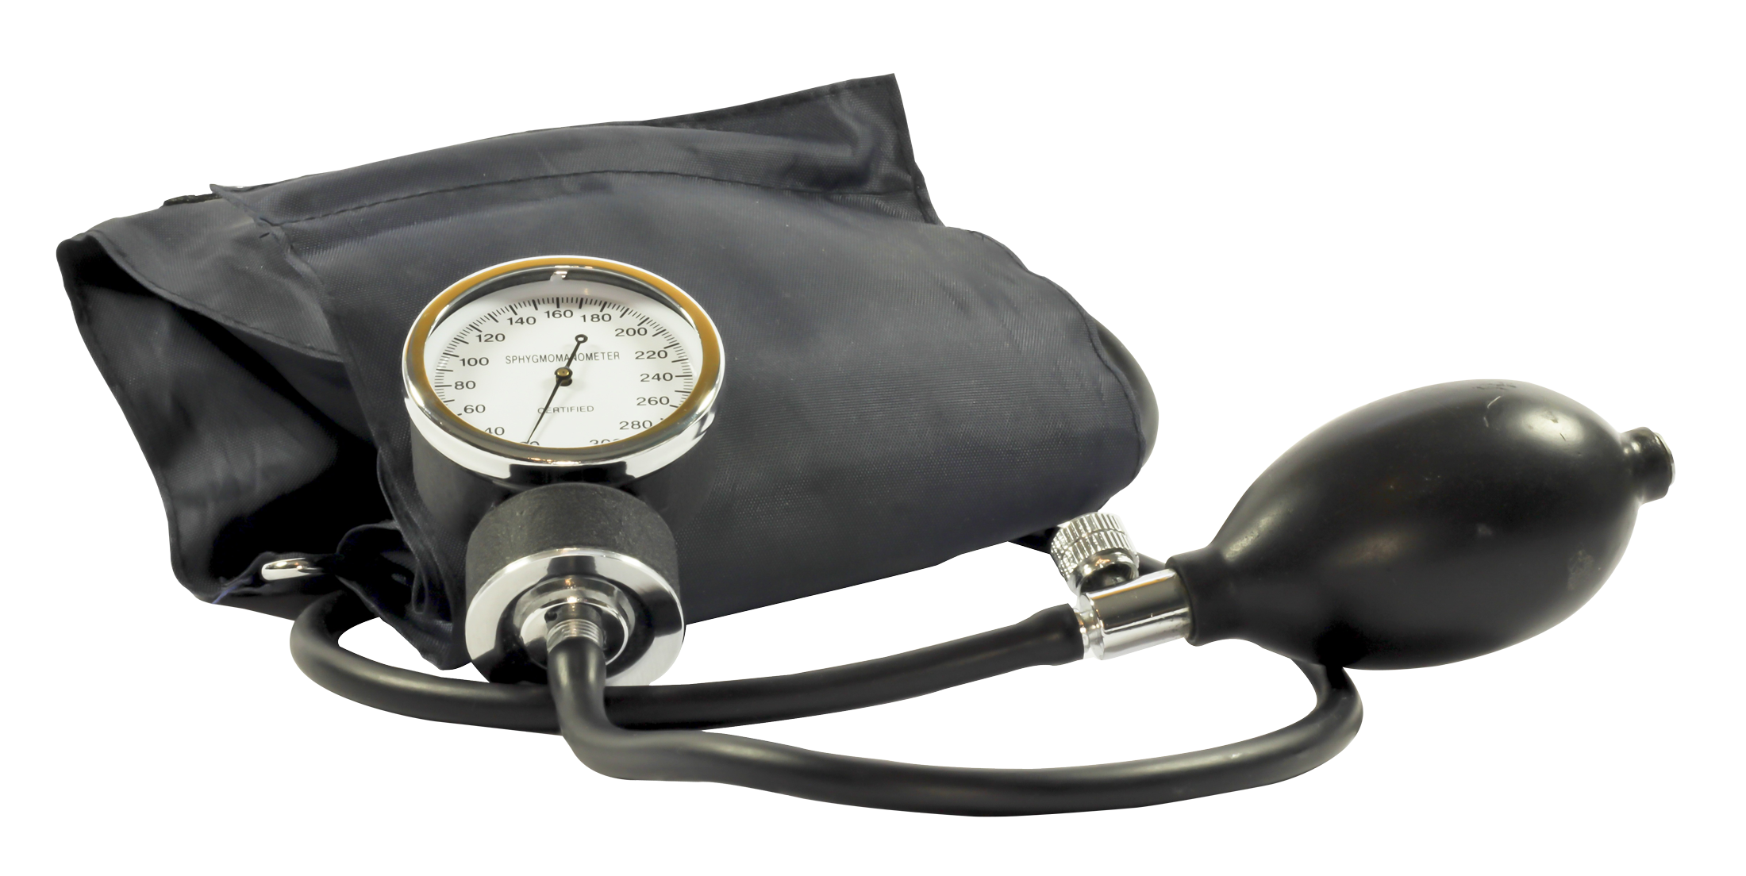
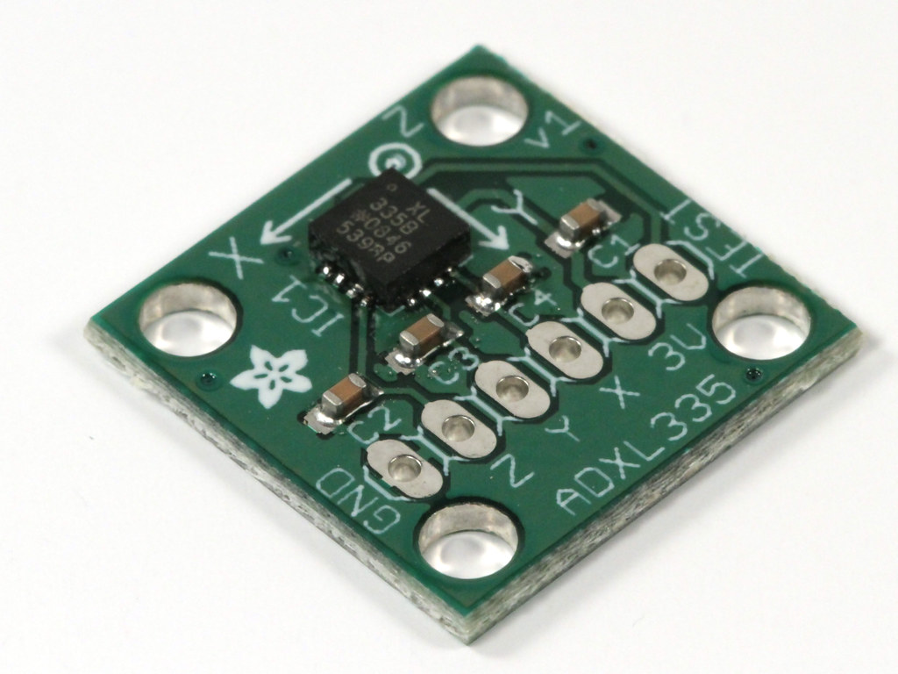
Blood Pressure Sensors Accelerometers
Function: Blood pressure sensors in healthcare IoT monitor blood pressure levels, providing valuable insights into cardiovascular health. They contribute to the diagnosis and management of hypertension.
Function: Accelerometers in healthcare IoT measure acceleration and movement. They play a key role in tracking physical activity and assessing mobility, contributing to overall health monitoring.
This Photo by Unknown Author is licensed under CC BY-NC
This Photo by Unknown Author is licensed under CC BY

Slide 5
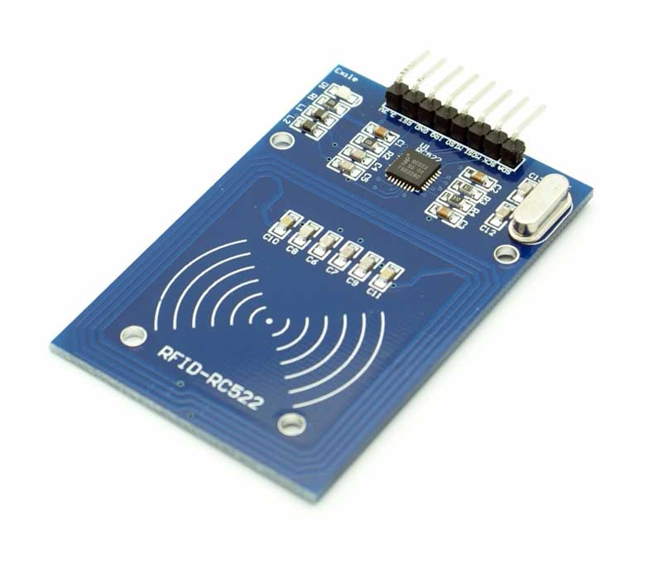
Data Transmission RFID Devices
Role: RFID devices in healthcare IoT play a crucial role in tracking and transmitting data wirelessly. They ensure the secure and efficient transmission of patient data.
Data transmission is a crucial aspect of healthcare IoT. An IoT Gateway acts as a bridge between devices and the cloud, facilitating secure and reliable data transmission.
This Photo by Unknown Author is licensed under CC BY-SA

Slide 6
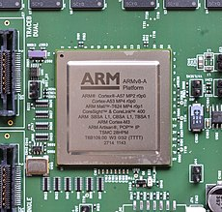
Data Processing
Overview: Data processing is central to healthcare IoT, and processors like the ARM Cortex-M series play a key role. These processors are known for their efficiency in low-power applications, making them suitable for wearable devices.
Significance: It is the brains behind the operation, efficiently handling health data. The ARM Cortex-M series ensures that wearable devices can capture, process, and transmit data seamlessly, contributing to the effectiveness of healthcare IoT.
This Photo by Unknown Author is licensed under CC BY-SA

Slide 7
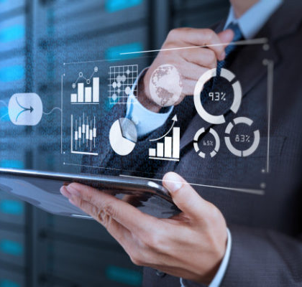
Data Management
Importance: Effective data management is critical in healthcare IoT. Ensuring the secure handling of sensitive health data is paramount to maintaining patient confidentiality and complying with regulations.
Safekeeping: We can imagine it as the digital vault safeguarding valuable health information. Data management practices play a pivotal role in preserving the integrity and privacy of patient data and fostering trust in the healthcare IoT ecosystem.
This Photo by Unknown Author is licensed under CC BY-SA-NC

Slide 8
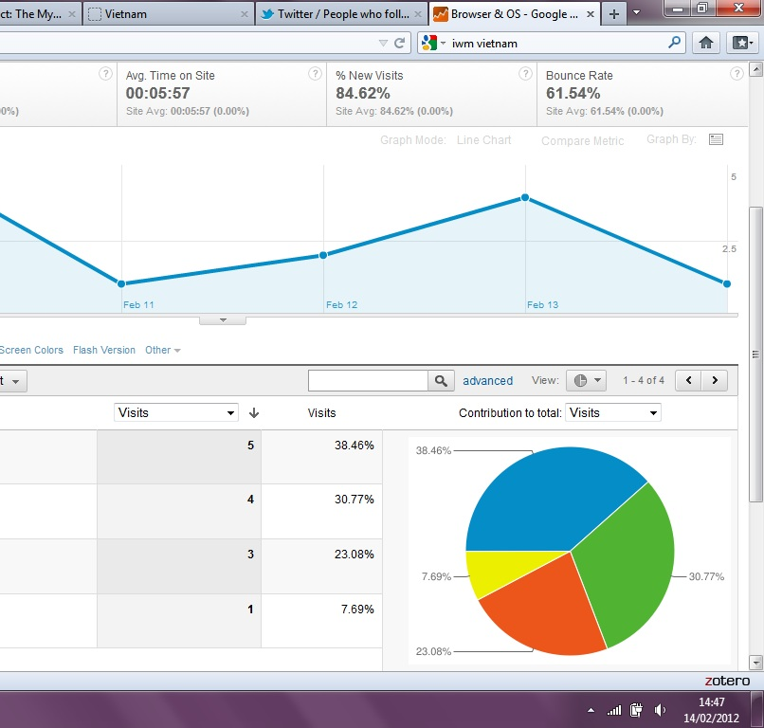
Data Analytics
Definition: Data analytics in healthcare IoT involves using machine learning algorithms for insightful analysis. Tools like TensorFlow for deep learning and Apache Spark for processing large datasets are instrumental.
Significance: We can think of it as the intelligence hub, uncovering patterns and insights. Data analytics tools contribute to the comprehensive understanding of health data, facilitating more informed and data-driven healthcare decisions.
This Photo by Unknown Author is licensed under CC BY-NC

Slide 9
Benefits of IOT in healthcare
Remote Patient Monitoring
IoT enables healthcare providers to remotely monitor patients' vital signs and health conditions, allowing for more timely and personalized interventions.
Real-time Data Collection
IoT devices can collect and transmit real-time data, providing healthcare professionals with up-to-date information for accurate diagnosis and treatment decisions.
Streamlined Workflow
IoT technologies streamline healthcare workflows by automating processes, reducing administrative burdens, and improving communication and coordination among healthcare teams.
Improved Patient Engagement
IoT applications promote patient engagement by enabling remote consultations medication reminders, and health tracking, empowering individuals to actively participate in their healthcare journey.

Slide 10
Enhanced Medication Management
IoT in Medication Management
IoT technology has the potential to revolutionize medication management in healthcare, improving patient safety and adherence to prescribed regimens.
Reducing Hospital Readmissions
One of the key applications of IoT in healthcare is reducing hospital readmissions. By leveraging connected devices and real-time data monitoring, healthcare providers can identify and address potential issues before they escalate, leading to better patient outcomes and reduced hospital readmissions.
Smart Pill Dispensers
Smart pill dispensers equipped with IoT technology can automatically dispense medications at the correct time and dosage, reducing the risk of medication errors and ensuring patients take their medications as prescribed.

Slide 11
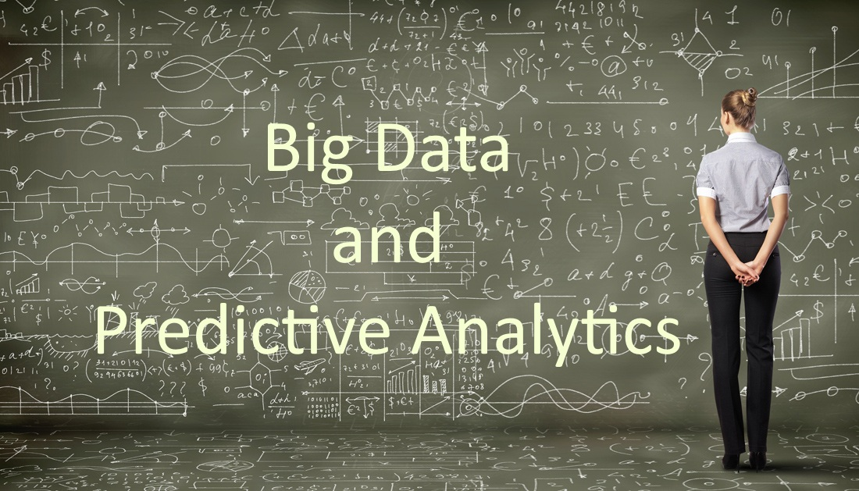
Predictive Analytics
Significance: Predictive analytics in healthcare IoT is a game-changer. Leveraging machine learning enhances proactive healthcare interventions by predicting potential health issues before they manifest.
IoT data combined with advanced analytics can enable predictive modeling and early detection of health issues, enabling proactive interventions and personalized treatment plans.
Efficient resource allocation and cost savings by prioritizing high-risk patients and optimizing healthcare delivery.

Slide 12
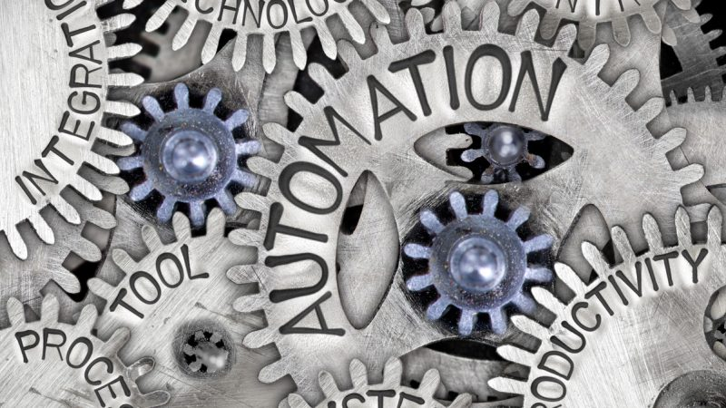
Enhancing Emergency Response
Real-time Monitoring
IoT enables real-time monitoring of patients' vital signs and health conditions, allowing healthcare providers to respond quickly in emergency situations.
Automatic Alerts
IoT devices can automatically generate alerts when certain health parameters deviate from normal ranges, enabling immediate intervention by medical professionals.
This Photo by Unknown Author is licensed under CC BY

Slide 13
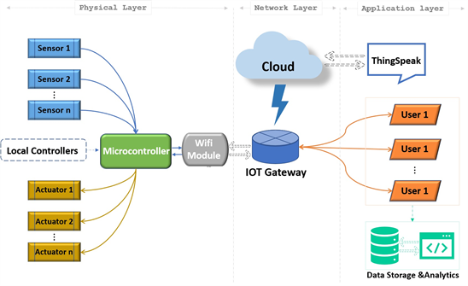
Integration and Interoperability
Need for Integration
Integration is crucial in IoT healthcare solutions to ensure seamless communication and data exchange between various devices and systems.
Importance of Interoperability
Interoperability enables different devices and systems to work together effectively, allowing for comprehensive and holistic patient care.
This Photo by Unknown Author is licensed under CC BY

Slide 14

Challenges And Risks
Data Privacy and Security
Implementing IoT in healthcare raises concerns about the privacy and security of patient data. It is crucial to establish robust security measures to protect sensitive information from unauthorized access and cyber threats.
In the context of IoT healthcare solutions, data security and privacy are of utmost importance. With the increasing amount of sensitive patient data being collected and transmitted, it is crucial to ensure that this data is protected from unauthorized access and breaches.
This Photo by Unknown Author is licensed under CC BY-SA

Slide 15
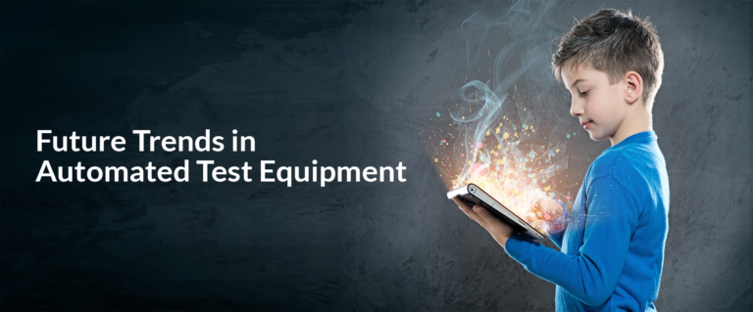
Future Trends and innovations
The future of healthcare IoT holds exciting possibilities. Anticipate continued advancements and innovations, such as AI-driven diagnostics and personalized medicine.
Evolution: Think of it as the unfolding chapters of a digital healthcare revolution. These future trends promise to reshape the landscape, offering new dimensions in patient care and healthcare delivery.
The Internet of Things (IoT) has the potential to revolutionize patient care by enabling real-time monitoring, remote diagnostics, and personalized treatments.
This Photo by Unknown Author is licensed under CC BY-SA-NC

Slide 16
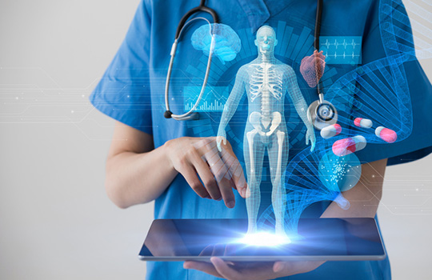
Artificial Intelligence in Healthcare
. Role of Artificial Intelligence
Artificial Intelligence (AI) plays a crucial role in revolutionizing patient care by providing advanced capabilities for data analysis, diagnosis, and treatment.
Potential Impact
The potential impact of AI in healthcare is immense. It can improve accuracy and efficiency in diagnosis, enable personalized treatment plans, and enhance patient monitoring and care.
This Photo by Unknown Author is licensed under CC BY

Slide 17
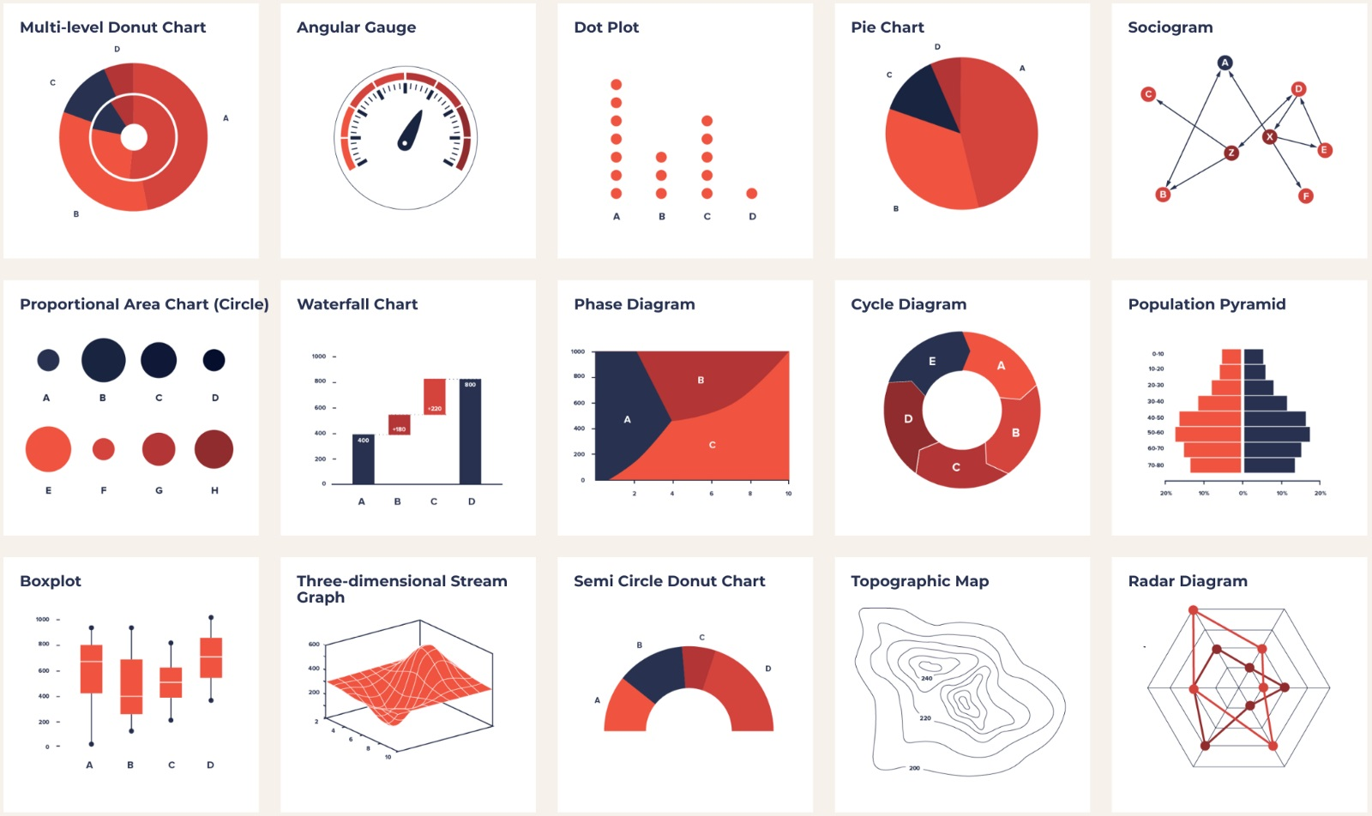
Data Visualization
Role: Data visualization is pivotal in healthcare decision-making. Line charts track vital signs over time, while pie charts display the distribution of medical conditions, providing clear and actionable insights.
Visualization: Picture it as the language of health data. These visual representations empower healthcare professionals to make informed decisions, transforming complex data into easily understandable and actionable insights.
This Photo by Unknown Author is licensed under CC BY-SA

Slide 18
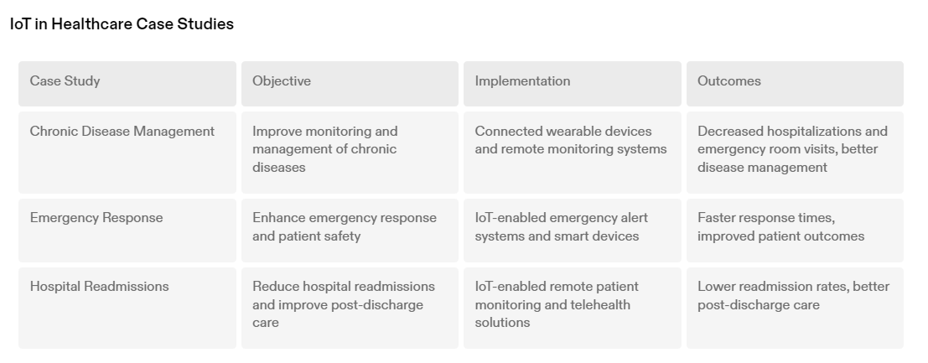
Case Studies
The successful implementation of IoT in healthcare has revolutionized patient care, leading to improved chronic disease management, enhanced emergency response, and reduced hospital readmissions.

Slide 19
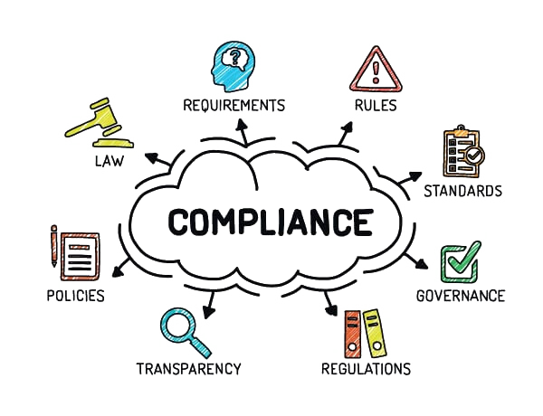
Regularity Compliance
HIPAA Compliance
Health Insurance Portability and Accountability Act (HIPAA) compliance is crucial for IoT healthcare solutions to ensure the privacy and security of patient data. It sets standards for the protection of sensitive patient information and mandates the implementation of technical safeguards, physical safeguards, and administrative safeguards.
FDA Regulations
The Food and Drug Administration (FDA) regulates medical devices and software used in healthcare. IoT healthcare solutions may need to comply with FDA regulations, including pre-market clearance or approval, post-market surveillance, and adherence to quality system regulations.
This Photo by Unknown Author is licensed under CC BY-NC

Slide 20

Conclusion
The potential of IoT in revolutionizing patient care is immense. By leveraging connected devices, healthcare providers can gather real-time data, monitor patients remotely, and make data-driven decisions. This technology has the power to improve patient outcomes, enhance the efficiency of healthcare delivery, and reduce costs. With IoT, the future of patient care is brighter than ever.
This Photo by Unknown Author is licensed under CC BY-SA

